Slide 1
Variant Calling (Part 1): Quality Control and Pre-processing
EPP 622
Bioinformatics Applications
Bode Olukolu
Assistant Professor
Entomology and Plant Pathology

Slide 2
Outline
Next-Generation Sequencing and Quality Controls (part 1)
Understanding multiplexed NGS libraries.
Base calling and quality scores.
Re-calibration of per-base quality scores.
Variant calling and filtering workflows (Part 2)
Alignment (reference genome/assembly, assembly errors, paralogs…).
SNP calling in diploids and polyploids.
Post-alignment quality control.
Post SNP calling QC
Filtering (read depth, quantitative genetics parameters)
Identifying variants types (SNP, indels, restriction site polymorphisms, epigenetic markers)

Slide 3
Suggested Reading:
Nielsen R, Paul JS, Albrechtsen A, Song YS. (2011) Genotype and SNP calling from next-generation sequencing data. Nat Rev Genet. 2011 Jun;12(6):443-51.
Irina A, Boekhorst R, Orlov Y. (2017) Computational errors and biases in short read Next Generation Sequencing. J Proteomics Bioinform. 10:1

Slide 4
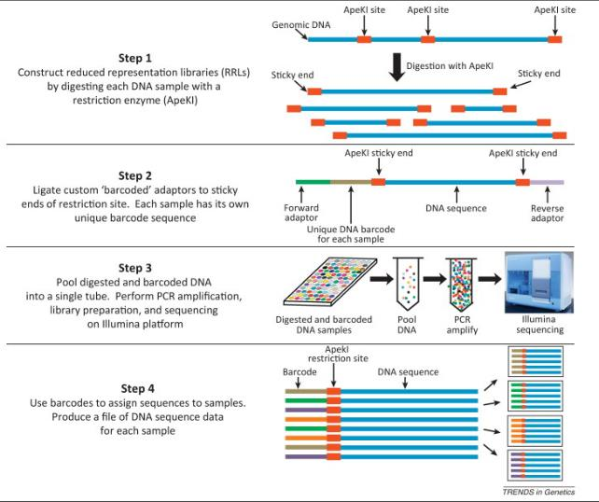
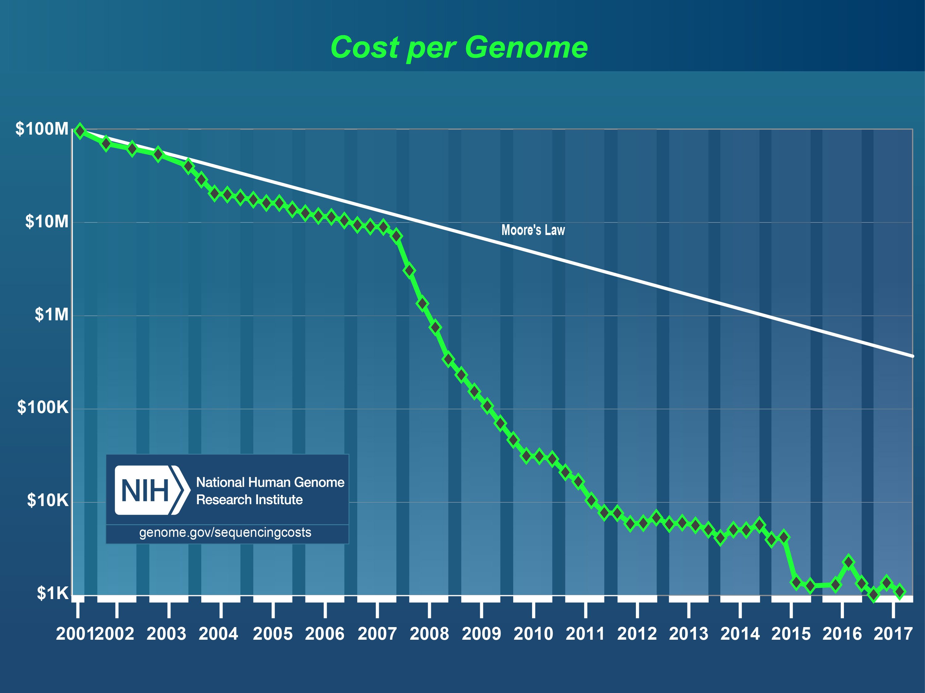
Introduction: sequencing-based genotyping
RAD-Seq (Restriction Site Associated DNA)
GBS (Genotyping-By-Sequencing)
ddRAD-Seq
DArTseq
GBSpoly
Capture-Seq
MonsterPlex
Elshire et al. (2011) PLoS ONE; Myles 2013, Trends in Genetics;
https://www.genome.gov/27565109/the-cost-of-sequencing-a-human-genome/

Slide 5
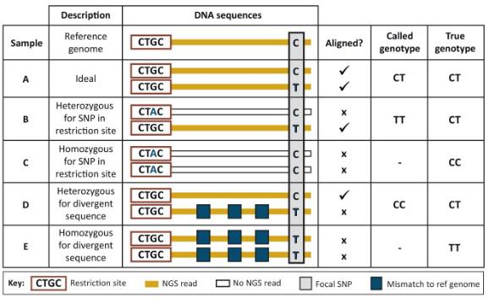
Sequencing-based genotyping pitfalls
NGS produces vast amount of data with error that is difficult to distinguish from true biological variation (leads to non-existent SNPs.)
Allele and Ascertainment bias
Difficulty in calling heterozygotes in diploids and dosage in polyploids
A lot of missing data.
Nonetheless, GBS assay is now commonly used and possibly the future of high-throughput genotyping.
Inexpensive
High-density markers
Useful for non-model organisms
Myles 2013, Trends in Genetics

Slide 6
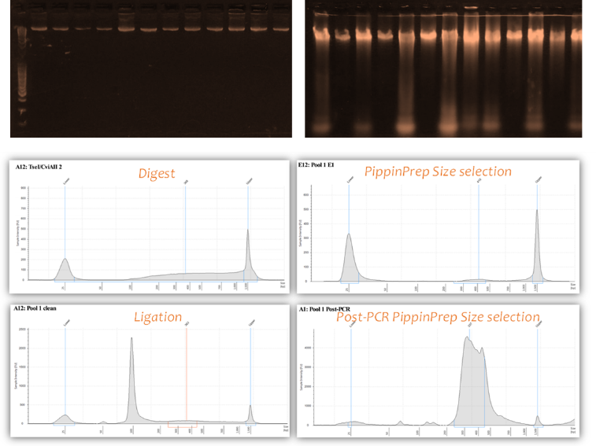
Library prep and quality control
Pre-library prep:
DNA quality check
Enzyme combination
Barcode/adapter design
Library prep:
Double digest
Adapter/barcode Ligation
Size selection
PCR amplification
Illumina sequencing
Good
(High Molecular weight DNA)
Bad (Smearing)

Slide 7
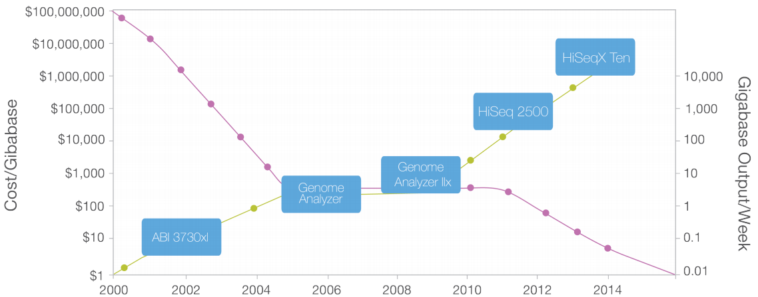
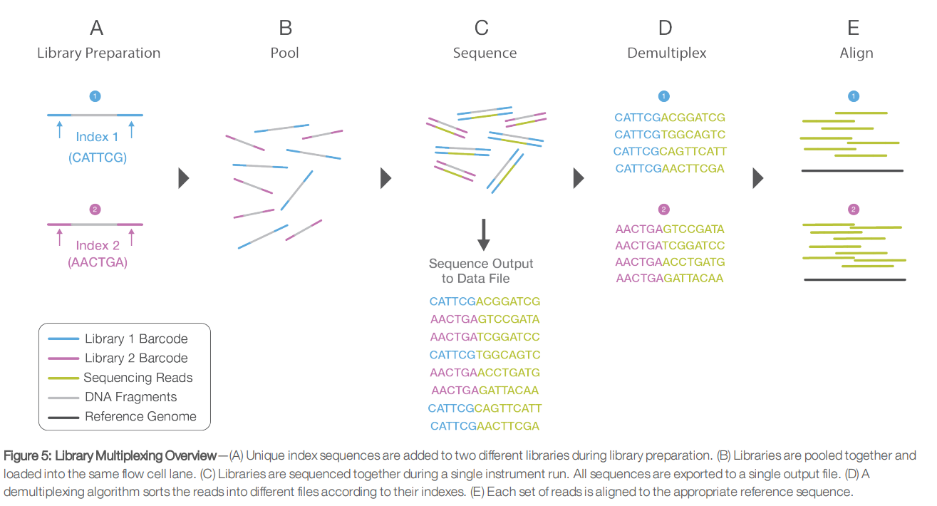
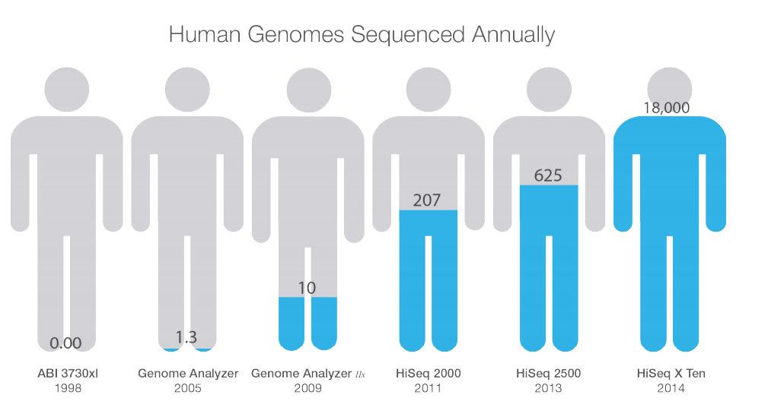
Why multiplex/pooled NGS libraries
Multiplex sequencing: large number of individual samples sequenced simultaneously.
Coverage from NGS equipment would be unnecessary for the reduced representation of a single genome (or small genome).
Translates to inexpensive assay
Illumina Inc.

Slide 8
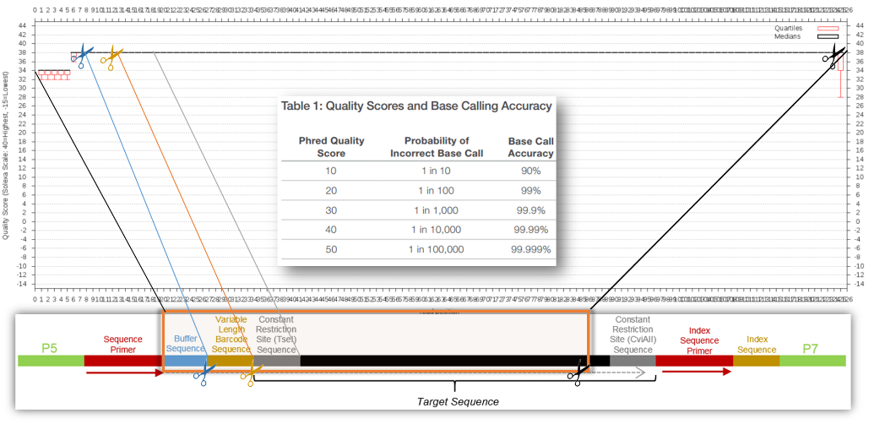
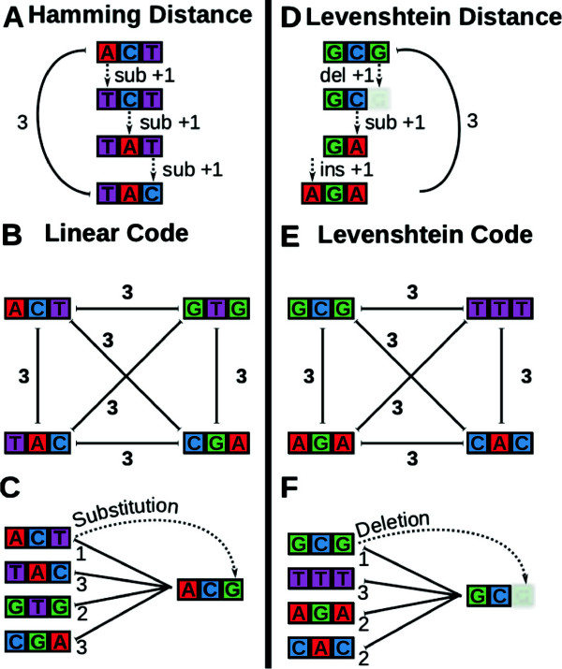
Considerations for multiplex-sequencing
Location of barcodes on the sequence read (problematic if located at proximal ends).
Demultiplexing accuracy.
“Hamming distance” vs. “edit/Levenshtein distance”.
Diversity of barcode nucleotide composition.
Variable length barcode to resolve phasing error.
Chimeric reads
Buschmann et al. (2013) BMC Bioinformatics;

Slide 9
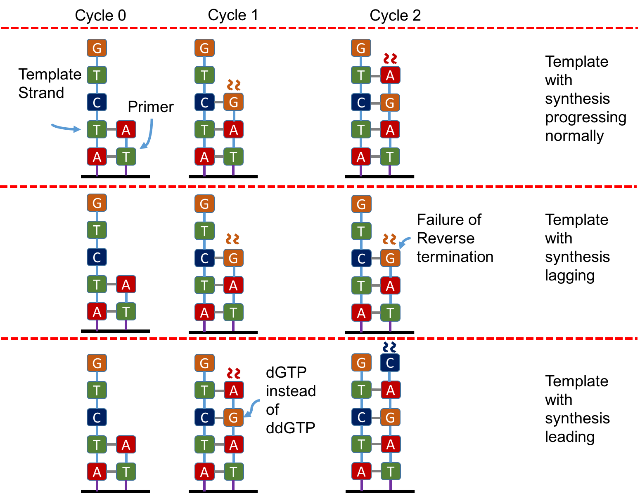
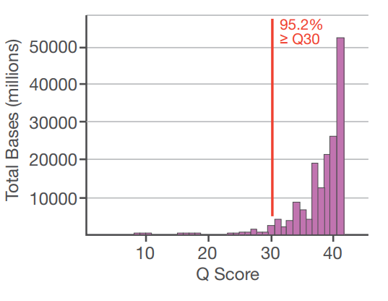
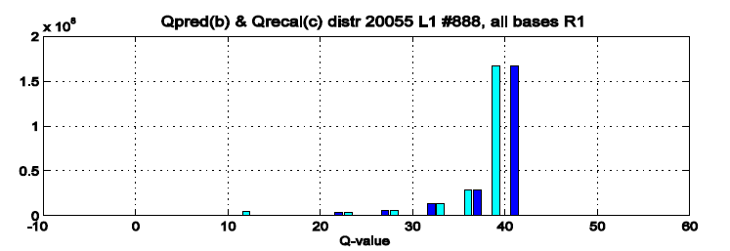
Illumina sequencing: sources of base calling error
Phasing error
Lack of diversity at position across samples (typical of A-tailed libraries and digested libraries retaining overhangs)
Unpredictable random errors along entire length of read (as shown in quality scores).
Quality scores seem to be approximations or binned values
QC plots only represent 95% of quality scores, hence, leading to false impression about random errors.
Illumina Inc; Irina et al. (2017) J. Proteomics Bioinform.; http://data-science-sequencing.github.io/Spr2016/lectures/lecture3/

Slide 10
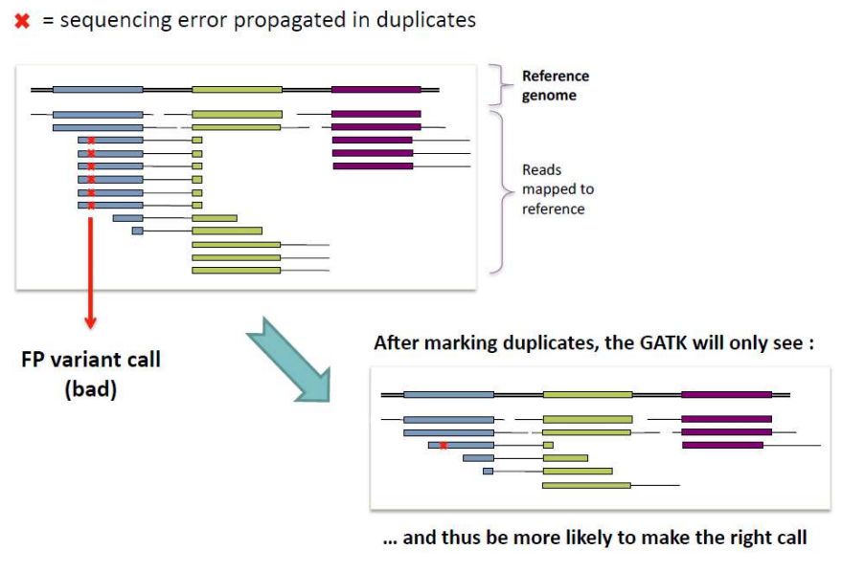
Removing PCR/optical duplicates
Marks reads that are duplicates and retains read with highest sum of base quality scores.
Not perfect:
- Does not account for sequencing errors
- Does not account for natural duplicates (paralogs)
- Does not account for duplicate reads with different mapping locations
Metzker ML (2010) Nat Rev Genet. 11(1):31-46

Slide 11
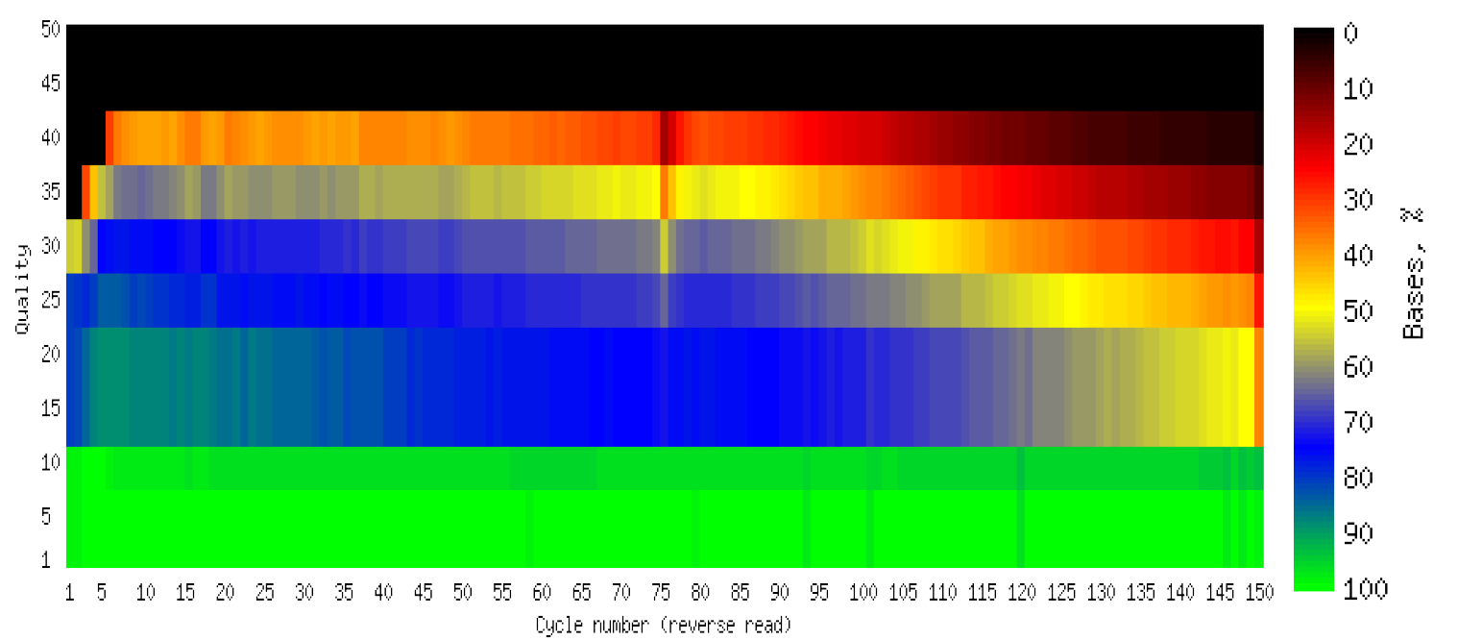
Base calling and quality scores
How to estimate miscall error rate?
High error rate at proximal ends of read inflated and crucial for demultiplexing pooled libraries.
A 1% error rate might seem miniscule, but retaining them in reads lead to non-existent SNP calls. This account for the inflated minor allele frequency observed in most GBs data.
Irina et al. (2017) J. Proteomics Bioinform.

Slide 12
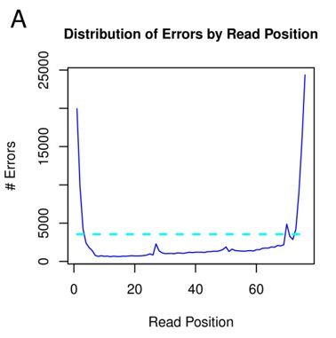
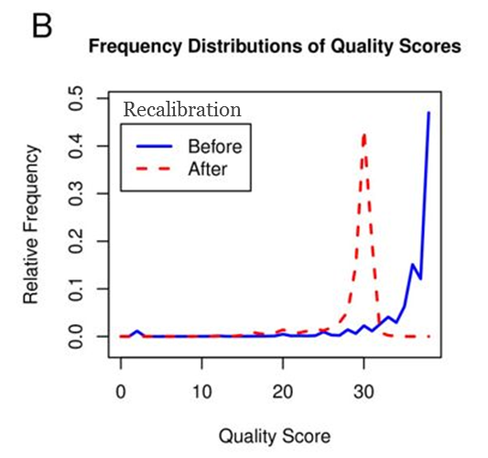
Re-calibration of per-base quality scores
Raw Phred-scaled quality scores produced from base-calling algorithms may not accurately reflect the true base-calling error rates.
Hence, need for recalibration.
SOAPsnp: recalibrated by comparing a sequenced genome to the reference genome at sites with no known SNPs. Algorithm estimates the empirical quality score by using the number of mismatches with respect to the reference genome.
GATK: A related alignment-based recalibration algorithm has been implemented in the GATK software. It also takes into account several covariates such as machine cycle and dinucleotide context
Cabanski et al. (2012) BMC Bioinformatics

Slide 13
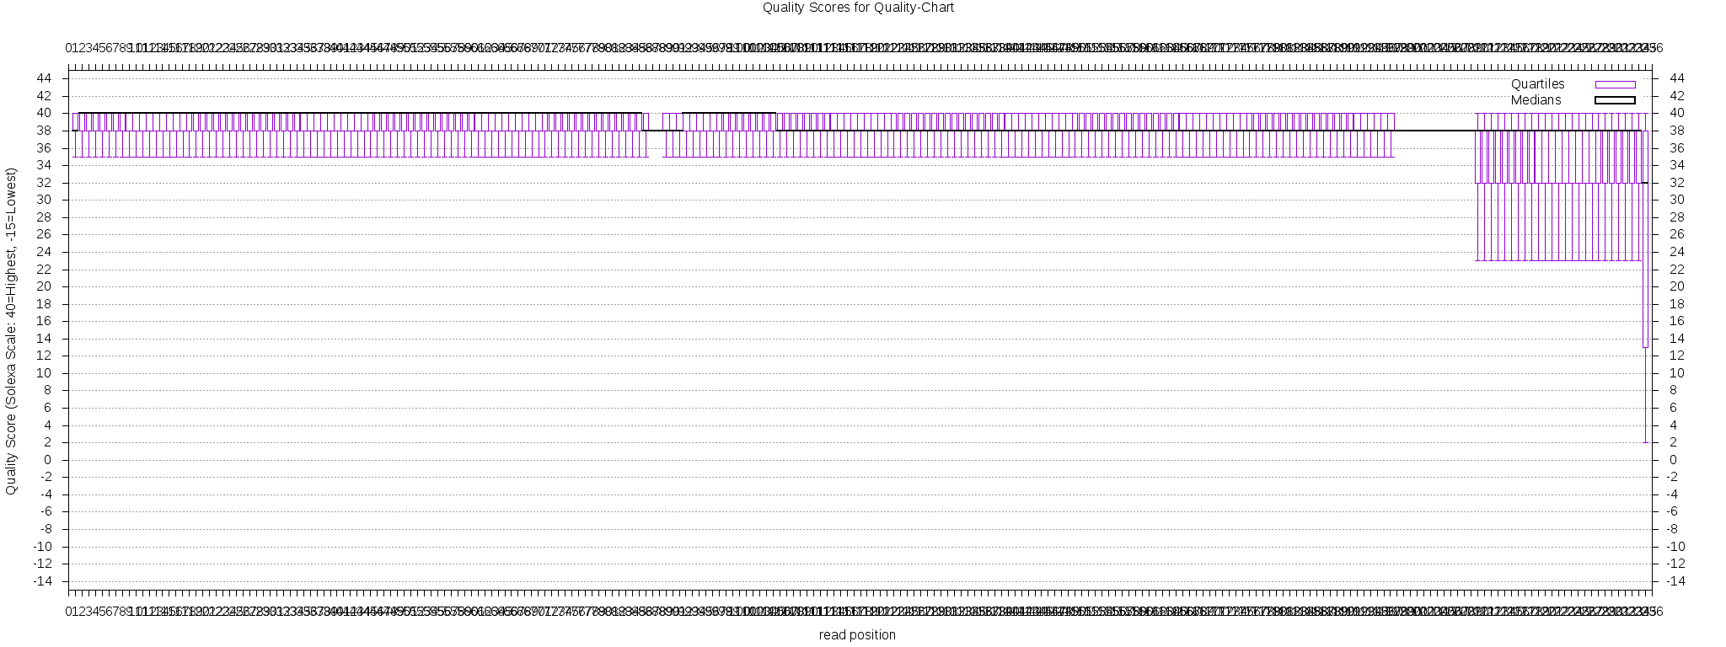
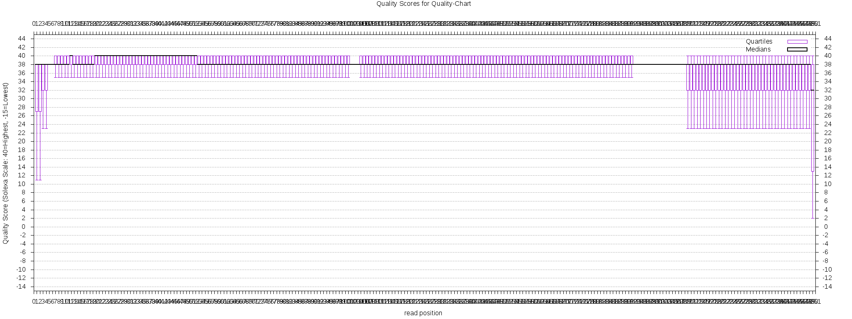
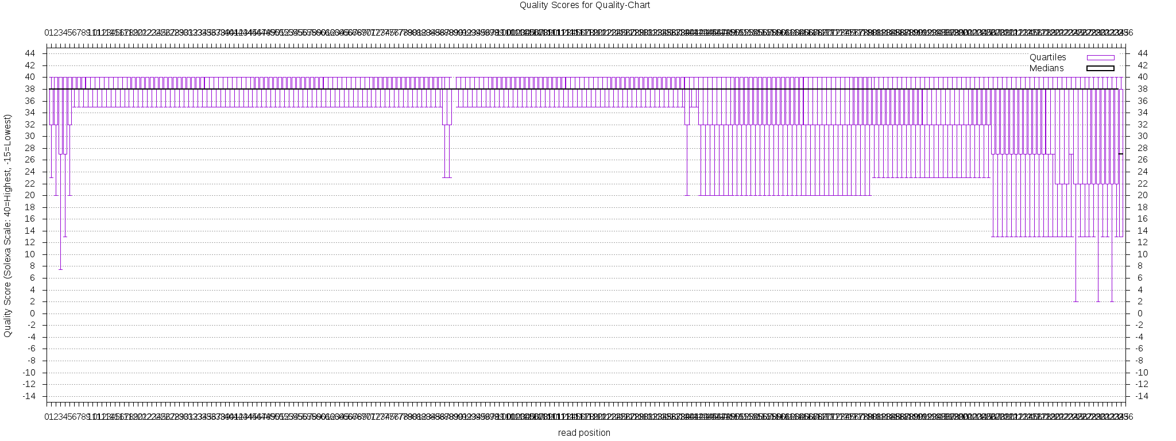
Error filtering: Forward Read
Matching restriction site sequence
Demultiplexed reads
Not matching restriction site sequence

Slide 14
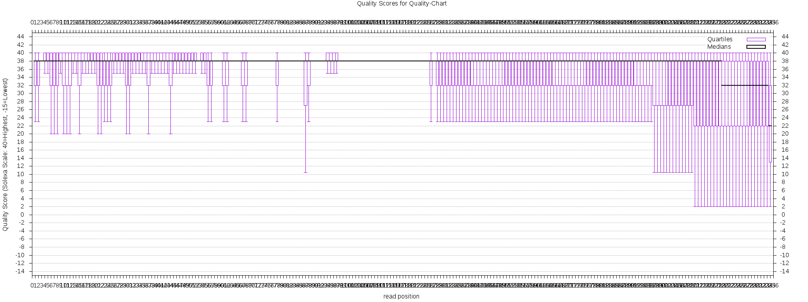
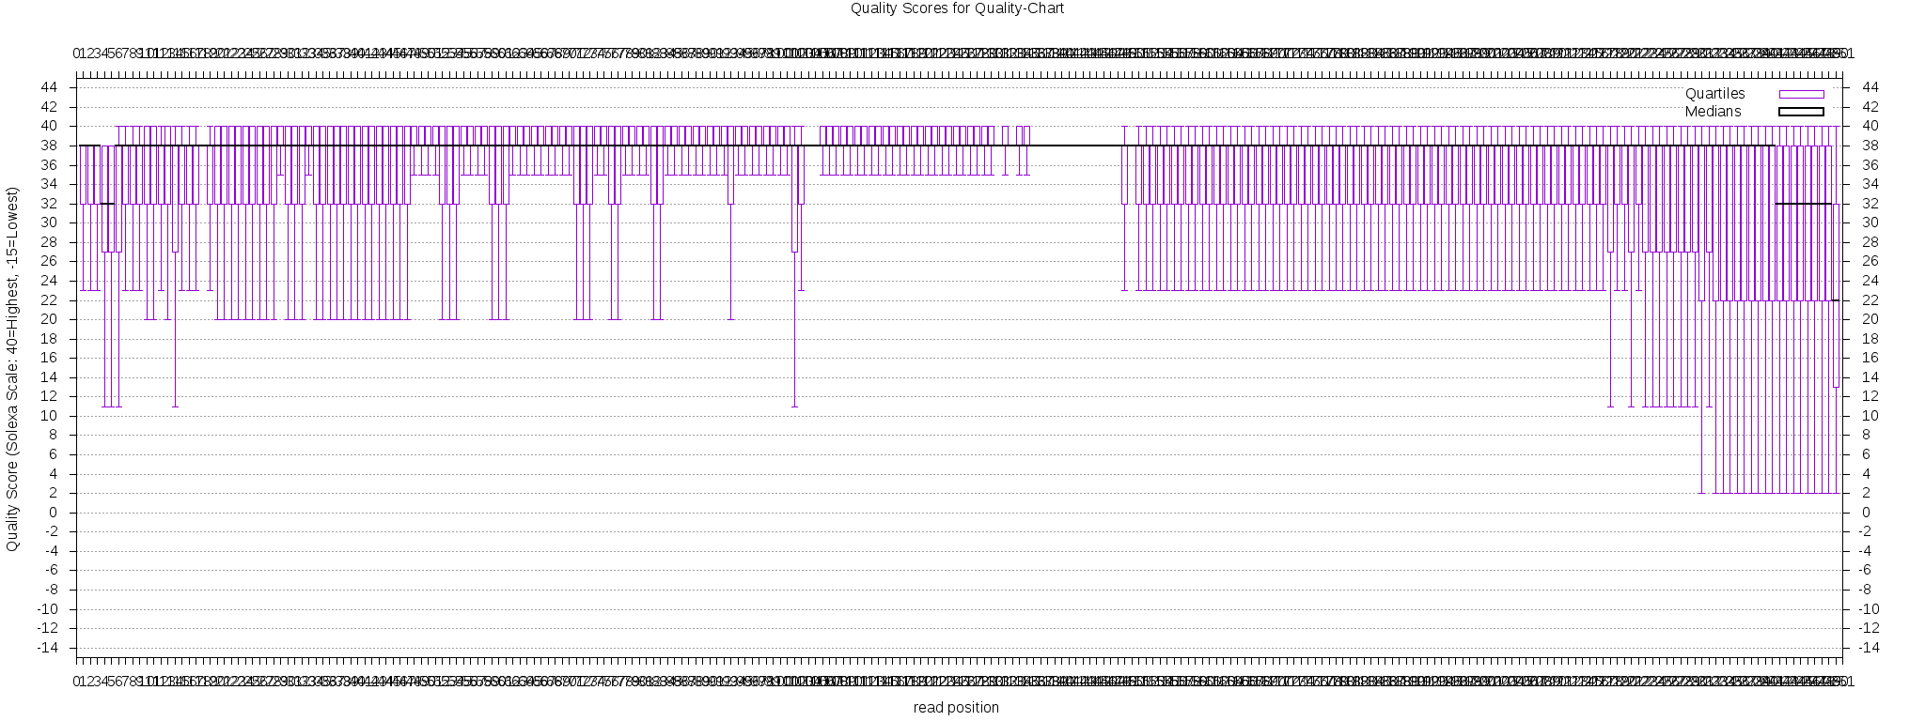
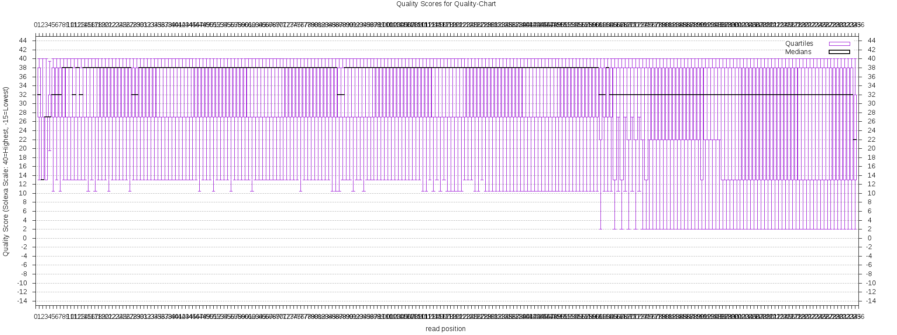
Error filtering : Reverse Read
Matching restriction site sequence
Demultiplexed reads
Not matching restriction site sequence

